Slide 1




Noida Institute of Engineering and Technology, Greater Noida
Exploratory Data Analysis
Unit: 4
Data Analytics ACSAI0512
Dr. Kumod Gupta
Associate Professor
CSE-AI
B.Tech 5th Semester

Slide 2
Faculty Introduction
Name | Dr. Kumod Kumar Gupta
Qualification | PhD
Designation | Associate Professor
Department | CSE- AI
NIET Experience | 03 Years
Subject Taught | Deep Learning, Machine Learning, Programming for Data Analytics

Slide 3
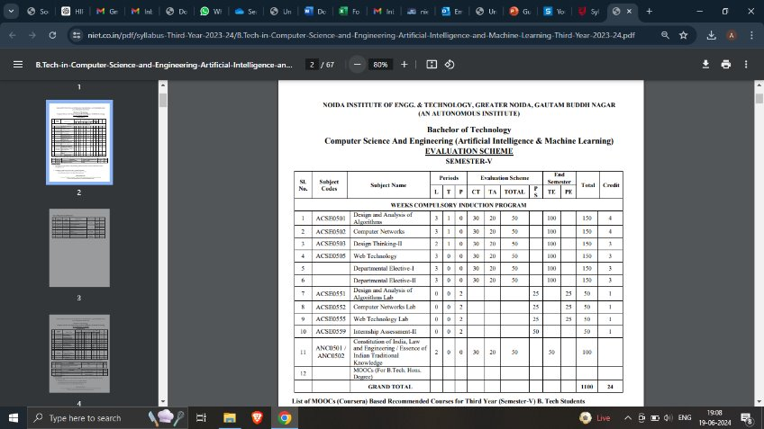
Evaluation Scheme

Slide 4
Syllabus
UNIT-I: Introduction to Data Science
Introduction to Data Science, Big Data, the 5 V’s, Evolution of Data Science, Datafication, Skillsets needed, Data Science Lifecycle, types of Data Analysis, Data Science Tools and technologies, Need for Data Science, Analysis Vs Analytics Vs Reporting, Big Data Ecosystem, Future of Data Science, Applications of Data Science in various fields, Use cases of Data science-Facebook, Netflix, Amazon, Uber, AirBnB.

Slide 5
Syllabus
UNIT-II: Data Handling
Type of Data: structured, semi-structured, unstructured data, Numeric, Categorical, Graphical, High Dimensional Data, Transactional Data, Spatial Data, Social Network Data, standard datasets, Data Classification, Sources of Data, Data manipulation in various formats, for example, CSV file, pdf file, XML file, HTML file, text file, JSON, image files etc. import and export data in R/Python.

Slide 6
Syllabus
UNIT-III: Data Preprocessing
Form of Data Pre-processing, data Attribute and its types, understanding and extracting useful variables,KDD process, Data Cleaning: Missing Values, Noisy Data, Discretization and Concept hierarchy generation (Binning, Clustering, Histogram), Inconsistent Data, Data Integration and Transformation. Data Reduction: Data Cube Aggregation, Data Compression, Numerosity Reduction

Slide 7
Syllabus
UNIT-IV: Exploratory Data Analysis
Handling Missing data, Removing Redundant variables, variable Selection, identifying outliers, Removing Outliers, Time series Analysis, Data transformation and dimensionality reduction techniques such as Principal Component Analysis (PCA), Factor Analysis (FA) and Linear Discriminant Analysis (LDA), Univariate and Multivariate Exploratory Data Analysis. Data Munging, Data Wrangling- APIs and other tools for scrapping data from the web/ internet using R/Python.

Slide 8
Syllabus
UNIT-V: Data Visualization
Introductions and overview, Debug and troubleshoot installation and configuration of the Tableau. Creating Your First visualization: Getting started with Tableau Software, Using Data file formats, connecting your Data to Tableau, creating basic charts (line, bar charts, Tree maps), Using the Show me panel. Tableau Calculations: Overview of SUM, AVR, and Aggregate Features Creating custom calculations and fields, Applying new data calculations to your visualization. Manipulating Data in Tableau: Cleaning-up the data with the Data Interpreter, structuring your data, Sorting, and filtering Tableau data, Pivoting Tableau data. Advanced Visualization Tools: Using Filters, Using the Detail panel Using the Size panels, customizing filters, Using and Customizing tooltips, Formatting your data with colours, Creating Dashboards & Stories, Distributing & Publishing Your Visualization

Slide 9
Branch Wise Applications
1.Security
2. Digital Advertising
3. E-Commerce
4. Publishing
5. Massively Multiplayer Online Games
6. Backend Services and Messaging
7. Project Management & Collaboration
8. Real time Monitoring Services
9.Live Charting and Graphing
10. Group and Private Chat

Slide 10
Course Objective
The objective of this course is to understand the fundamental concepts of Data analytics and learn about various types of data formats and their manipulations. It helps students to learn exploratory data analysis and visualization techniques in addition to R/Python/Tableau programming language.

Slide 11
Course Outcomes
At the end of course, the student will be able to:
Understand the fundamental concepts of data analytics in the areas that plays major role within the realm of data science.
Explain and exemplify the most common forms of data and its representations.
Understand and apply data pre-processing techniques.
Analyse data using exploratory data analysis.
Illustrate various visualization methods for different types of data sets and application scenarios.

Slide 12
Program Outcomes
Engineering Graduates will be able to:
PO1 : Engineering Knowledge
PO2 : Problem Analysis
PO3 : Design/Development of solutions
PO4 : Conduct Investigations of complex problems
PO5 : Modern tool usage
PO6 : The engineer and society

Slide 13
Program Outcomes
Engineering Graduates will be able to:
PO7 : Environment and sustainability
PO8 : Ethics
PO9 : Individual and teamwork
PO10 : Communication
PO11 : Project management and finance
PO12 : Life-long learning

Slide 14

CO-POs Mapping
CO.K | PO1 | PO2 | PO3 | PO4 | PO5 | PO6 | PO7 | PO8 | PO9 | PO10 | PO11 | PO12
CO1 | 2 | 2 | 2 | 3 | 3 | - | - | - | - | - | - | -
CO2 | 3 | 2 | 3 | 2 | 3 | - | - | - | - | - | - | -
CO3 | 3 | 2 | 3 | 2 | 3 | - | - | - | - | - | - | -
CO4 | 3 | 2 | 3 | 2 | 3 | - | - | - | - | - | - | -
CO5 | 3 | 2 | 3 | 3 | 3 | - | - | - | - | - | - | -
AVG | 2.8 | 2.0 | 2.8 | 2.4 | 3.0 | - | - | - | - | - | - | -

Slide 15
Program Specific Outcomes
S. No. | Program Specific Outcomes (PSO) | PSO Description
1 | PSO1 | Design innovative intelligent systems for the welfare of the people using machine learning and its applications.
2 | PSO2 | Demonstrate ethical, professional and team - oriented skills while providing innovative solutions in Artificial Intelligence and Machine Learning for life-long learning.

Slide 16
CO-PSOs Mapping
CO.K | PSO1 | PSO2 | PSO3 | PSO4
CO1 | 3 | - | - | -
CO2 | 3 | 2 | - | -
CO3 | 3 | 3 | - | -
CO4 | 3 | 3 | - | -
CO5 | 3 | 3 | - | -

Slide 17
Program Educational Objectives
Program Educational Objectives (PEOs) | PEOs Description
PEOs | Pursue higher education and professional career to excel in the field of Artificial Intelligence and Machine Learning.
PEOs | Lead by example in innovative research and entrepreneurial zeal for 21st century skills.
PEOs | Proactively provide innovations solutions for societal problems to promote life-long learning.
Aarushi Thusu ACSAI0622 Social Media Analytics Unit 5

Slide 18
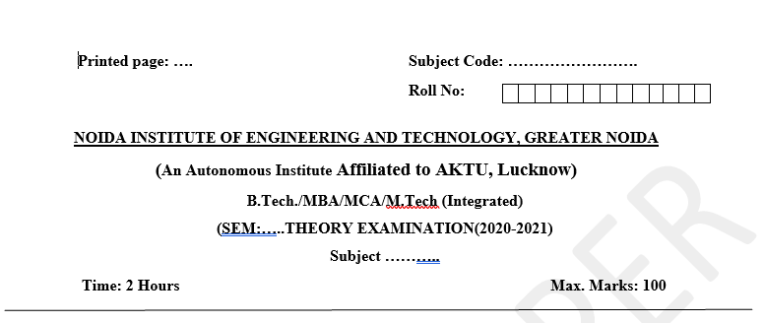
Pattern of External Exam Question Paper

Slide 19
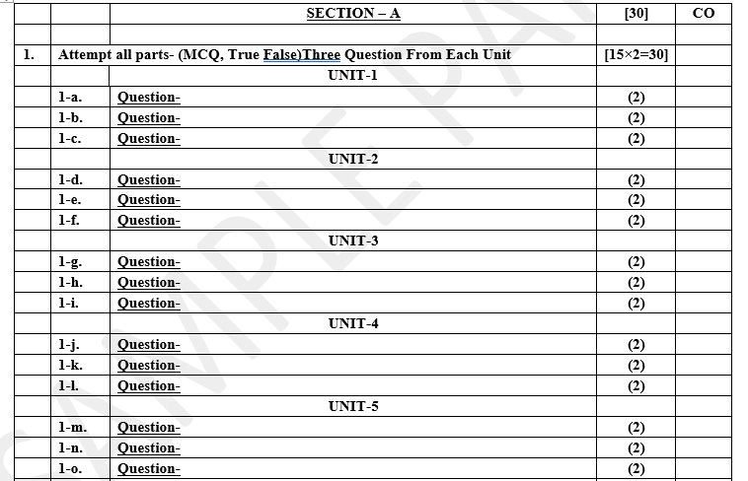
Pattern of External Exam Question Paper

Slide 20
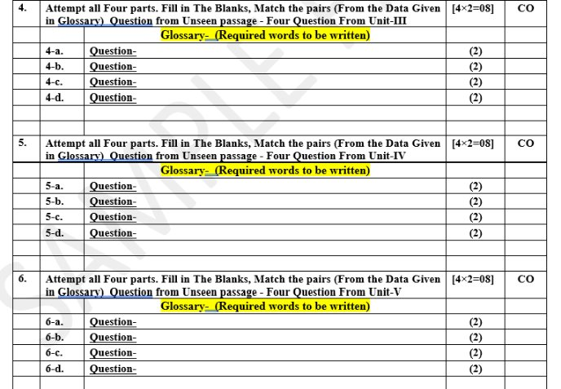
Pattern of External Exam Question Paper

Slide 21
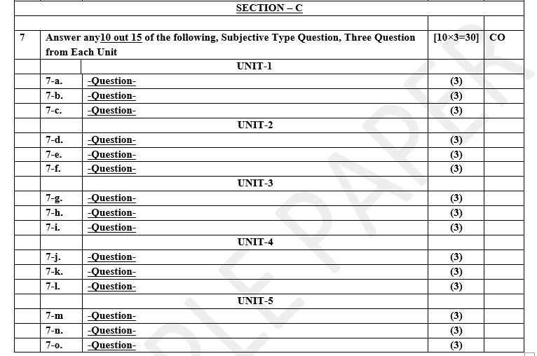
Pattern of External Exam Question Paper

Slide 22
Brief Introduction about the Subject and Videos
Data analytics (DA) is the area of examining data sets in order to find trends and draw conclusions about the information they contain. Increasingly, data analytics is done with the aid of specialized systems and software.
YouTube/other Video Links
https://www.youtube.com/watch?v=KxryzSO1Fjs

Slide 23
Unit Content
Unit -4 Exploratory Data Analysis
Handling Missing data,
Removing Redundant variables,
variable Selection,
identifying outliers,
Removing Outliers,
Time series Analysis,
Data transformation and dimensionality reduction techniques
Principal Component Analysis (PCA),
Factor Analysis (FA) and
Linear Discriminant Analysis (LDA),
Univariate and Multivariate Exploratory Data Analysis.
Data Munging, Data Wrangling- APIs and other tools for scrapping data from the web/ internet using R/Python.

Slide 24
Unit Objectives
The objective of the Unit 4 is :
To describe how to handle the missing data.
To remove the redundant variable.
To explore Data transformation and dimensionality reduction techniques such as Principal Component Analysis (PCA), Factor Analysis (FA) and Linear Discriminant Analysis (LDA)
To describe the services an operating system provides to users, processes, and other systems
To discuss Data Munging, Data Wrangling- APIs and other tools for scrapping data from the web/ internet using Python.

Slide 25
Exploratory Data Analysis
Exploratory Data Analysis (EDA) is the process of investigating a dataset to summarize its key characteristics, often using statistical techniques and visualizations.
EDA is crucial in understanding the data before applying more complex statistical models or machine learning algorithms.
It helps in identifying patterns, spotting anomalies, testing hypotheses, and checking assumptions.
Objectives of EDA:
Discover patterns: Identify trends, clusters, and relationships.
Spot anomalies or outliers: Detect unusual or extreme values.
Test hypotheses: Evaluate assumptions about the data.
Determine relationships: Understand how different variables interact.

Slide 26
Exploratory Data Analysis
Key EDA Techniques:
Descriptive Statistics:
Summarize the data using metrics such as mean, median, mode, range, variance, and standard deviation.
Data Visualization:
Histograms: Show the distribution of a variable.
Box plots: Highlight the spread and potential outliers.
Scatter plots: Display relationships between two continuous variables.
Heatmaps: Visualize correlations between multiple variables.
Missing Data Analysis:
Identify missing values and determine strategies to handle them (e.g., imputation, removal).
Correlation and Covariance:
Quantify the relationships between variables using correlation matrices or covariance calculations.

Slide 27
Exploratory Data Analysis
Benefits of EDA:
Improved Data Understanding: Helps you understand the structure and relationships within the data.
Error Detection: Helps identify data errors, missing values, or outliers that could affect results.
Hypothesis Generation: EDA can help in forming new hypotheses for further analysis.
Model Selection: Helps in choosing the right type of machine learning models by understanding data distributions and relationships.

Slide 28
Exploratory Data Analysis
these four primary types of Exploratory Data Analysis (EDA):
1. Univariate
Univariate Non-Graphical EDA
Focus: Analyzing a single variable without using visual tools.
Techniques:
Summary statistics: Mean, median, mode, variance, standard deviation.
Frequency distribution tables: Count how often each value occurs.
Purpose: Understand the central tendency, spread, and shape of the distribution.
Univariate Graphical EDA
Focus: Analyzing one variable using visual methods.
Techniques:
Histograms: Show the distribution of the variable.
Box plots: Highlight the spread, median, and potential outliers.
Density plots: Show the probability density of the variable.
Purpose: Gain better insights into the distribution, shape, and spread of the data.

Slide 29
Exploratory Data Analysis
2. Bivariate Analysis
Bivariate Non-Graphical EDA:
Focuses on the relationship between two variables using measures like correlation coefficients (e.g., Pearson’s correlation).
Bivariate Graphical EDA:
Uses visual tools like scatter plots, bar plots, and line charts to explore relationships between two variables.

Slide 30
Exploratory Data Analysis
3. Multivariate
Multivariate Non-Graphical EDA
Focus: Analyzing relationships between two or more variables without visual representation.
Techniques:
Cross-tabulation (contingency tables): Summarizes categorical data to show relationships between variables.
Correlation coefficients: Show the strength of relationships between numerical variables.
Purpose: Understand the interaction between variables through numerical or tabular data.
Multivariate Graphical EDA
Focus: Visualizing relationships between two or more variables.
Techniques:
Scatter plots: Display the relationship between two continuous variables.
Pair plots: Display relationships between multiple pairs of variables.
Heatmaps: Show correlations between many variables at once.
3D plots or contour plots: Used for visualizing more complex multivariate relationships.
Purpose: Discover patterns, correlations, and potential interactions among variables visually.

Slide 31
Handling Missing data
Missing Values:-
The data has some missing values in its columns. There are three major categories of missing values:
MCAR (Missing completely at random): These are values that are randomly missing and do not depend on any other values.
MAR (Missing at random): These values are dependent on some additional features.
MNAR (Missing not at random): There is a reason behind why these values are missing.

Slide 32
Handling Missing data
MCAR (Missing Completely at Random)
MAR (Missing at Random)
MCAR (Missing Completely at Random) refers to a situation where the missing data is independent of both the observed and unobserved data in the dataset.
In other words, the likelihood of any particular value being missing is unrelated to any of the variables in the dataset. The missingness occurs purely by chance, and there’s no systematic reason for why the data is missing.
Characteristics of MCAR:
Completely Random: The missing data is random and not influenced by any variables (neither the missing variable itself nor any other variables).
No Bias Introduced: If data is MCAR, dropping the missing data or filling it with simple imputations (like the mean) won’t introduce bias in the analysis.
Hard to Prove: It’s difficult to verify that data is MCAR because you need to show that the missing data is not related to any variables.

Slide 33
Handling Missing data
Example of MCAR:
Imagine you’re conducting a survey where some participants don’t answer a question about their favorite color.
If the missing responses are completely random and not related to the participants’ age, gender, or any other factor, this is MCAR.
The fact that the data is missing is purely due to chance, like someone accidentally skipping a question.

Slide 34
Handling Missing data
How to Handle MCAR:
1. Remove Missing Data: If the percentage of missing data is small, you can safely drop the rows or columns with missing data, as it won’t bias the results.
# Drop rows with missing values
df.dropna()
# Drop columns with missing values
df.dropna(axis=1)
2. Simple Imputation: You can use simple imputation methods like filling missing values with the mean, median, or mode, since the data is missing randomly and this won’t introduce bias.
# Fill missing values with mean
df['column_name'].fillna(df['column_name'].mean(), inplace=True)

Slide 35
Handling Missing data
Impact of MCAR:
No Bias: Since the missingness is completely random, removing or imputing the data won’t significantly affect the results or introduce bias.
Efficiency Loss: While MCAR doesn't introduce bias, removing too much data can reduce the sample size, leading to a loss in the statistical power of your analysis.
Conclusion:
When data is MCAR, it’s the simplest case to handle. You can safely remove or fill in the missing data without worrying about bias.
However, confirming that your data is truly MCAR can be challenging in practice, as you need to demonstrate that the missing data is completely unrelated to any other factors.

Slide 36
Handling Missing data
Imputation is the process of filling in missing data values with substituted values to allow for complete data analysis.
2. MAR (Missing at Random) data, where the missingness is dependent on other observed variables, specific imputation techniques can be used to estimate the missing values.
Imputation Techniques for MAR:
a) Mean, Median, or Mode Imputation:
Method: Replace the missing values with the mean, median, or mode of the observed data for a particular variable.
Usage: Simple but effective when the relationship between variables isn’t complex.
Limitation: Can underestimate variability and distort relationships between variables.

Slide 37
Handling Missing data
b) Imputation Using Other Features (Regression Imputation):
Method: Use regression models to predict the missing value based on other related features. For example, if age is missing, you can predict it using related variables like income or education level.
Usage: More appropriate for MAR data, as it accounts for the relationship between variables.
Limitation: Can still introduce bias if the assumptions of the regression model are violated.
c) K-Nearest Neighbours (KNN) Imputation:
Method: Finds the "K" closest observations (neighbours) to a missing data point and imputes the missing value based on the average (or mode) of these neighbours.
Usage: Works well for numerical and categorical data when the dataset is relatively small and relationships between features exist.
Limitation: Computationally expensive for large datasets

Slide 38
Handling Missing data
Why Imputation for MAR is Important:
For MAR data, simple deletion of rows or columns containing missing data could lead to biased results, as the missingness is systematically related to other observed variables.
Imputation techniques, especially those that take other variables into account, help minimize this bias and preserve the integrity of the data.

Slide 39
Handling Missing data
Comparison of MCAR and MAR
Feature | MCAR (Missing Completely at Random) | MAR (Missing at Random)
Missingness depends on | Nothing (completely random) | Observed variables (but not the missing values)
Effect on analysis | No bias if data is dropped | Can introduce bias if not handled correctly
Handling | Can drop or use simple imputation methods (mean, median) | More advanced imputation needed (regression, KNN, multiple imputation)

Slide 40
Handling Missing data
Implications of imputation
Imputation has some effects that can impact analysis.
The central tendency of data is retained. For example, if we impute missing data using the mean of a numeric variable, the mean after imputation will not change. This is a good reason to impute based on estimates of central tendency.
The spread of the data will change. After imputation, the spread of the data will be smaller relative to spread if we ignore missing values. This could be problematic as underestimating the spread of data can yield over-confident inferences in downstream analysis.

Slide 41
Removing Redundant variables
1. Removing redundant columns -
Sometimes more than one column can contain the same/similar value. In that case having two columns does not add any value to the model. So, it is wise to delete the redundant column.
2. Remove redundant rows -
This depends on the use case, but if having duplicate records does not make sense, then it is wise to remove the redundant rows -
df.drop_duplicates()

Slide 42
Variable selection
Variable selection, also called feature selection, is the process of choosing the most important variables (or features) from a dataset for building a machine learning model. This helps improve the model's performance and reduces the time it takes to train.
There are three main types of variable selection techniques:
Filter Methods: These techniques rank variables based on statistical measures like correlation. You select the top-ranked variables for the model. Common methods include:
Correlation coefficient
Chi-square test
Variance threshold
Wrapper Methods: These methods evaluate different combinations of variables by actually building models on them. They are more accurate but take more time. Examples include:
Forward selection (starting with no variables and adding the best ones one by one)
Backward elimination (starting with all variables and removing the least important ones)
Recursive feature elimination (removing the least important feature repeatedly)
Embedded Methods: These techniques perform variable selection during the model training process. Some algorithms, like decision trees or LASSO (L1 regularization), have built-in feature selection.
Choosing the right variables can make your model simpler and better at predictions.

Slide 43
Variable selection
Typical preventive measures during variable selection include:
Collaboration with experts in the field to identify the important variables.
Awareness of any problems in relation to data source, reliability or mismeasurement.
Cleaning the data.
Using control variables to account for banned variables or specific events such as an economic drift.

Slide 44
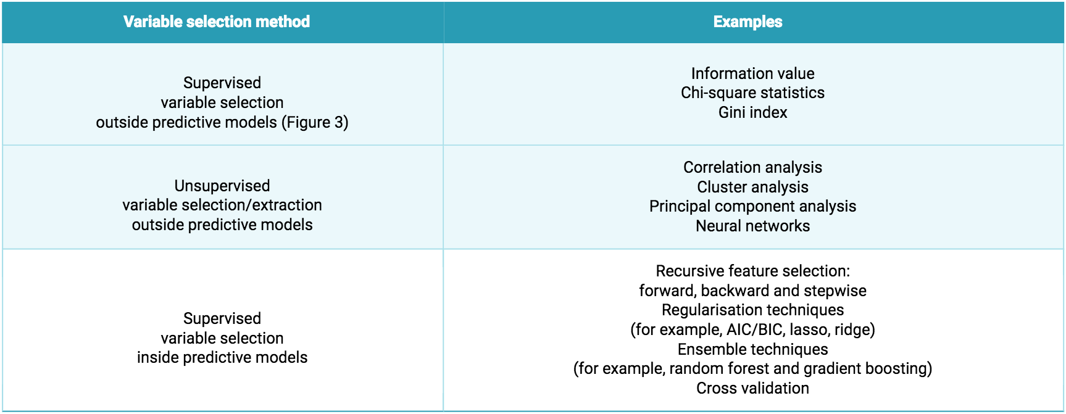
Variable selection

Slide 45
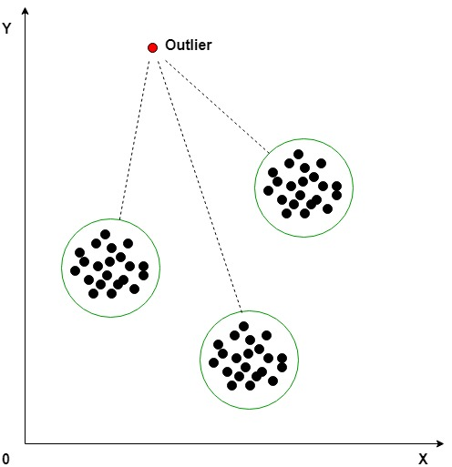
Identifying Outliers
An outlier is something separate or different from the crowd. Outliers can be a result of a mistake during data collection or it can be just an indication of variance in your data. Some of the methods for detecting and handling outliers:
Box Plot
Scatter plot
Z-score
IQR(Inter-Quartile Range)

Slide 46
Identifying Outliers
Outlier Detection Methods in Machine Learning
Outlier detection plays a crucial role in ensuring the quality and accuracy of machine learning models.
By identifying and removing or handling outliers effectively, we can prevent them from biasing the model, reducing its performance, and hindering its interpretability. Here’s an overview of various outlier detection methods:
1. Statistical Methods:
Z-Score: This method calculates the standard deviation of the data points and identifies outliers as those with Z-scores exceeding a certain threshold (typically 3 or -3).
Interquartile Range (IQR): IQR identifies outliers as data points falling outside the range defined by Q1-k*(Q3-Q1) and Q3+k*(Q3-Q1), where Q1 and Q3 are the first and third quartiles, and k is a factor (typically 1.5).

Slide 47
Identifying Outliers
Distance-Based Methods:
K-Nearest Neighbors (KNN): KNN identifies outliers as data points whose K nearest neighbors are far away from them.
Local Outlier Factor (LOF): This method calculates the local density of data points and identifies outliers as those with significantly lower density compared to their neighbors.
3. Clustering-Based Methods:
Density-Based Spatial Clustering of Applications with Noise (DBSCAN): In DBSCAN, clusters data points based on their density and identifies outliers as points not belonging to any cluster.
Hierarchical clustering: Hierarchical clustering involves building a hierarchy of clusters by iteratively merging or splitting clusters based on their similarity. Outliers can be identified as clusters containing only a single data point or clusters significantly smaller than others.
https://www.geeksforgeeks.org/machine-learning-outlier/

Slide 48
Remove Outliers
To remove outliers from a dataset, you can follow different approaches depending on the method of detection and the type of data you're working with. Here’s a simple guide:
Steps to Remove Outliers:
Identify the Outliers: First, you need to detect the outliers using methods such as the Z-score, Interquartile Range (IQR), or visualization tools like box plots.
a) Using Z-score (for numerical data):
b) Using IQR (Interquartile Range):
The IQR method finds the spread of the middle 50% of the data and marks values outside a certain range as outliers.

Slide 49
Time Series Analysis
Time series analysis is a method used to analyze data that is collected over time.
The goal is to understand the patterns, trends, and behaviors of the data and to make predictions for the future.
Common examples of time series data include stock prices, weather measurements, and sales figures over time.
Here are some key concepts in time series analysis:
Trend: A long-term increase or decrease in the data. For example, if sales data shows a steady rise over years, that's a trend.
Seasonality: Recurring patterns or cycles in the data at specific times, such as higher sales during the holiday season or higher temperatures in summer.
Noise: Random variation in the data that can't be explained by trends or seasonality. Noise makes it harder to see the patterns clearly.
Stationarity: A time series is stationary if its statistical properties (like mean and variance) don't change over time. If the data shows trends or seasonality, it is non-stationary.
Autocorrelation: This measures how a time point in the series is related to earlier time points. In simple terms, it helps you see if past values are influencing future values.

Slide 50
Time Series Analysis
Popular models for time series analysis include:
ARIMA (Auto Regressive Integrated Moving Average):
A widely used model that combines autoregressive (AR), differencing (I for integrated), and moving average (MA) elements.
Exponential Smoothing:
A method that gives more weight to recent data points for making predictions.
LSTM (Long Short-Term Memory networks): A type of neural network that is often used for time series forecasting, especially when working with deep learning.

Slide 51
Time Series Analysis
Why organizations use time series data analysis
Organizations use time series data analysis for several reasons, primarily because it helps them make informed decisions based on trends, patterns, and future predictions.
Here are some key reasons why organizations use time series analysis:
Forecasting Future Trends
Sales Forecasting: Retailers and businesses analyze historical sales data to predict future demand, allowing them to adjust inventory, marketing strategies, and production schedules accordingly.
Stock Market Predictions: Financial organizations use time series analysis to forecast stock prices, currency exchange rates, and interest rates, helping them make investment decisions.
2. Understanding Patterns
Seasonality Detection: Organizations can detect seasonal trends, such as higher sales during the holiday season or increased electricity consumption during summer, and plan operations around these patterns.
Customer Behavior Analysis: Time series analysis helps companies understand when customers are most active or likely to make purchases, aiding in targeted marketing.

Slide 52
Time Series Analysis
3. Anomaly Detection
Fraud Detection: Financial institutions monitor time series data to identify unusual patterns that could indicate fraudulent transactions.
Equipment Failure Prediction: In industries like manufacturing, time series data from sensors can be used to predict when a machine might fail, enabling preventive maintenance.
4. Risk Management
Market Risk: Financial firms analyze time series data to assess market risks, such as potential stock market crashes, allowing them to take measures to mitigate these risks.
Supply Chain Optimization: Companies use time series data to anticipate disruptions or delays in the supply chain and adjust operations accordingly.

Slide 53
Time Series Analysis
5. Improving Operations
Inventory Management: By analyzing historical sales data, companies can optimize inventory levels, ensuring they stock the right amount of products at the right time.
Staffing and Resource Allocation: Time series analysis helps organizations predict peak times and allocate resources like staffing or equipment effectively.
6. Financial Analysis
Revenue Projections: Companies can project future revenue by analyzing past performance trends.
Budgeting and Cost Management: Time series analysis helps organizations manage their finances by predicting future expenses and revenues.

Slide 54
Time Series Analysis
7. Optimization of Marketing Campaigns
Targeted Advertising: Time series data helps marketers understand when specific products or services are in demand, allowing them to target advertisements at the right time.
Customer Engagement: Companies use time series analysis to find the best times to engage with customers via promotions, emails, or ads.
By leveraging time series data, organizations can not only understand their past and current performance but also position themselves to make better decisions for the future. This data-driven approach leads to improved efficiency, cost savings, and increased profitability.

Slide 55
Time Series Analysis
Time series analysis examples:- Examples of time series analysis in action include:
Weather data
Rainfall measurements
Temperature readings
Heart rate monitoring (EKG)
Brain monitoring (EEG)
Quarterly sales
Stock prices
Automated stock trading
Industry forecasts
Interest rates

Slide 56
Time Series Analysis
Time Series Analysis Types
Classification: Identifies and assigns categories to the data.
Curve fitting: Plots the data along a curve to study the relationships of variables within the data.
Descriptive analysis: Identifies patterns in time series data, like trends, cycles, or seasonal variation.
Explanative analysis: Attempts to understand the data and the relationships within it, as well as cause and effect.

Slide 57
Time Series Analysis
Time Series Analysis Types
Exploratory analysis
Forecasting
Intervention analysis: Intervention analysis is a statistical method used to assess the impact of an event or intervention on a time series. It helps determine whether a specific event has caused a significant change in the behavior of the data over time. This method is commonly used in areas such as economics, marketing, and medicine, where researchers are interested in understanding how policies, treatments, or changes in conditions influence outcomes.
Segmentation : Segmentation is the process of dividing a larger set of data into smaller, more manageable or meaningful parts, often called segments. It’s widely used in various fields like marketing, image processing, and machine learning, to make data analysis more focused and efficient.

Slide 58
Time Series Analysis
Types of Segmentation:
Market Segmentation:
Definition: In marketing, segmentation refers to dividing a broad consumer or business market into subgroups based on shared characteristics.
Types:
Demographic Segmentation: Dividing based on age, gender, income, education, etc.
Geographic Segmentation: Dividing based on location (country, city, region).
Behavioral Segmentation: Based on behavior patterns, like buying habits, brand loyalty.
Psychographic Segmentation: Based on lifestyle, personality traits, values, and interests.
Purpose: Helps companies target specific groups with tailored marketing strategies, leading to more efficient use of resources and higher customer satisfaction.

Slide 59
Time Series Analysis
2. Image Segmentation:
Definition: In image processing, segmentation refers to dividing an image into different parts or regions to make it easier to analyze and interpret.
Types:
Thresholding: Divides the image into segments based on pixel intensity (e.g., separating dark objects from bright backgrounds).
Edge-Based Segmentation: Detects boundaries or edges of objects in the image.
Region-Based Segmentation: Divides the image into regions based on similarities (color, texture).
Clustering Methods (e.g., K-means): Group pixels that are similar in characteristics, such as color or intensity.
Purpose: Used for tasks like object detection, medical image analysis, and facial recognition, making images easier for computers to process.

Slide 60
Time Series Analysis
3. Customer Segmentation in Machine Learning:
Definition: In machine learning, segmentation often involves grouping data points (such as customers) based on similarities in their behavior or characteristics.
Methods:
Clustering Algorithms (e.g., K-means, DBSCAN): These algorithms group similar data points without predefined labels.
Decision Trees: These can be used to segment data by creating branches based on feature importance.
Principal Component Analysis (PCA): Reduces the dimensionality of the data to find segments in high-dimensional spaces.
Purpose: Helps businesses predict customer behavior, improve personalization, and increase retention by understanding different customer groups better.

Slide 61
Data transformation and dimensionality reduction
Dimensionality Reduction refers to the technique of reducing the dimension of a data feature set. Usually, machine learning datasets (feature set) contain hundreds of columns (i.e., features) or an array of points, creating a massive sphere in a three-dimensional space. By applying dimensionality reduction, you can decrease or bring down the number of columns to quantifiable counts, thereby transforming the three-dimensional sphere into a two-dimensional object (circle).

Slide 62
Data transformation and dimensionality reduction
Dimensionality reduction has many other benefits, such as:
It eliminates noise and redundant features.
It helps improve the model’s accuracy and performance.
It facilitates the usage of algorithms that are unfit for more substantial dimensions.
It reduces the amount of storage space required (less data needs lesser storage space).
It compresses the data, which reduces the computation time and facilitates faster training of the data.

Slide 63
Data transformation and dimensionality reduction
Dimensionality Reduction Techniques:-Dimensionality reduction techniques can be categorized into two broad categories:
1. Feature selection
The feature selection method aims to find a subset of the input variables (that are most relevant) from the original dataset. Feature selection includes three strategies, namely:
Filter strategy
Wrapper strategy
Embedded strategy

Slide 64
Data transformation and dimensionality reduction
Dimensionality Reduction Techniques
2. Feature extraction
Feature extraction, feature projection, converts the data from the high-dimensional space to one with lesser dimensions. This data transformation may either be linear or it may be nonlinear as well. This technique finds a smaller set of new variables, each of which is a combination of input variables (containing the same information as the input variables).
​

Slide 65
Weekly/Monthly Assignment
What is Data Pre-processing?
What is Data cleaning?
Explain KDD process.
What is Data Reduction?
What is Data Discretization?
Explain Dimensionality Reduction.
What is Inconsistency of Data?
What is Outliers?
Explain Binning Techniques.
What is Data Cube aggregation?

Slide 66

Data transformation and dimensionality reduction
1. Principal Component Analysis (PCA)
Principal Component Analysis is one of the leading linear techniques of dimensionality reduction.
It is a statistical procedure that orthogonally converts the ‘n’ coordinates of a dataset into a new set of n coordinates, known as the principal components. This conversion results in the creation of the first principal component having the maximum variance.

Slide 67
Principal component analysis
Cake | Milk | Lemon | Juice | Oil | PC1(Paneer) | PC2(Ghee)
PCA is an unsupervised method as it does not use the output information

Slide 68
Principal component analysis
Principal component analysis (PCA) is a dimensionality reduction unsupervised machine learning method
which is used to reduce the number of variables of a dataset into a smaller number of variables while preserving/maintaining significant patterns and trends in the dataset.
Principal components are new variables that are constructed as linear combinations or mixtures of the initial variables.
These combinations are done in such a way that the new variables (i.e., principal components) are uncorrelated and most of the information within the initial variables is squeezed or compressed into the first components.
So, the idea is 10-dimensional data gives you 10 principal components, but PCA tries to put maximum possible information in the first component, then maximum remaining information in the second and so on, until having something like shown in the scree plot below.

Slide 69
Principal component analysis
In Principal Component Analysis (PCA), PC1 (first principal component) and PC2 (second principal component) are uncorrelated because PCA is designed to create new axes (principal components) that are orthogonal (i.e., at 90 degrees) to each other. This means that:
PC1 and PC2 capture different types of variance: PC1 explains the maximum variance in the data, and PC2 explains the second highest variance in the data but in a direction that is orthogonal to PC1. Since they are orthogonal, their dot product is zero, implying no correlation.
Pc1.Pc2 = Pc1.Pc2 Cos θ where θ = 90
Pc1.Pc2 = 0
No linear relationship: If two variables are uncorrelated, there is no linear relationship between them. In PCA, this means that knowing the value of PC1 gives you no information about PC2, and vice versa.

Slide 70
Principal component analysis
2D to 1 D across Axis

Slide 71
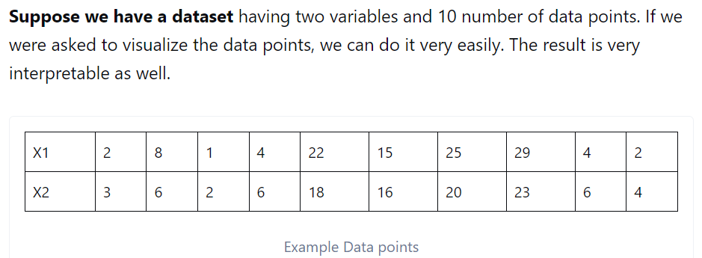
Principal component analysis

Slide 72
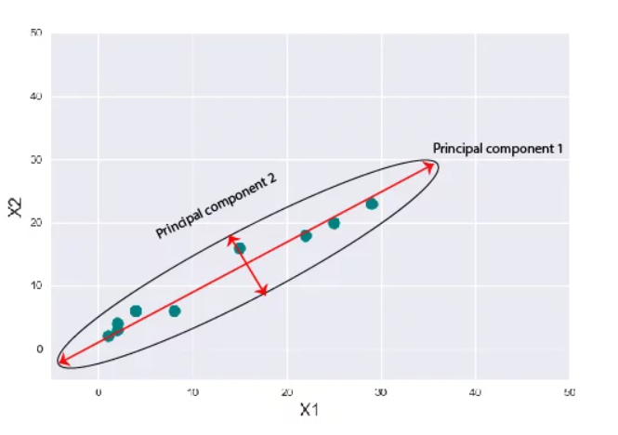
Principal component analysis

Slide 73
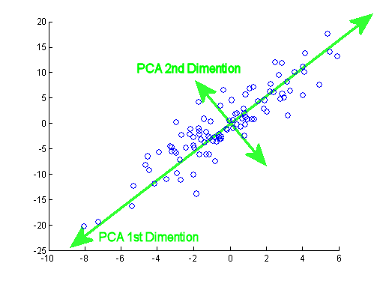
Principal component analysis

Slide 74
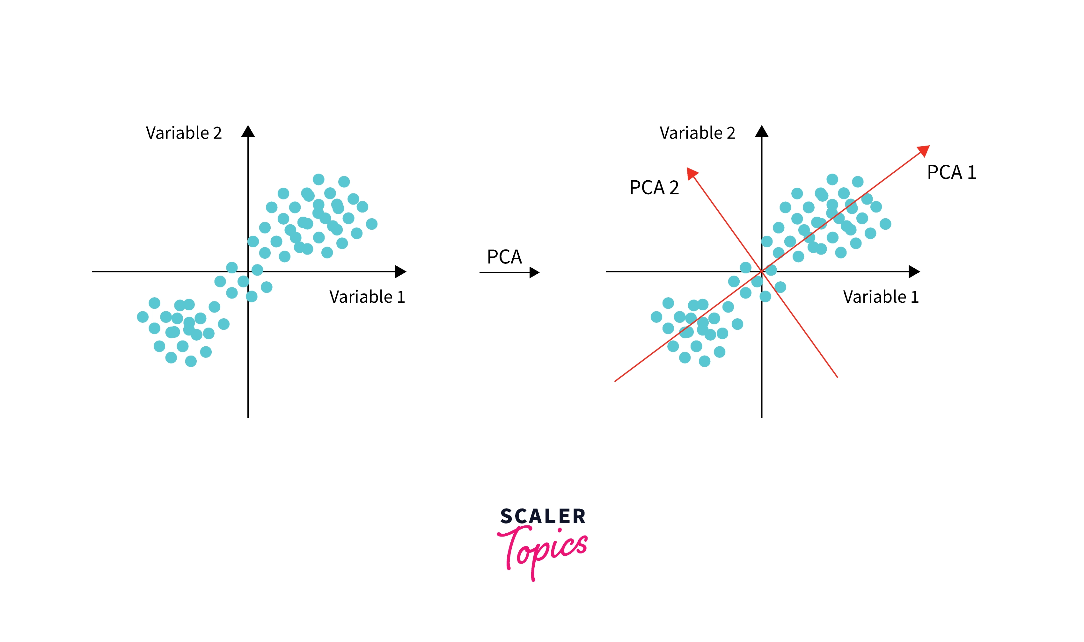
Principal component analysis

Slide 75
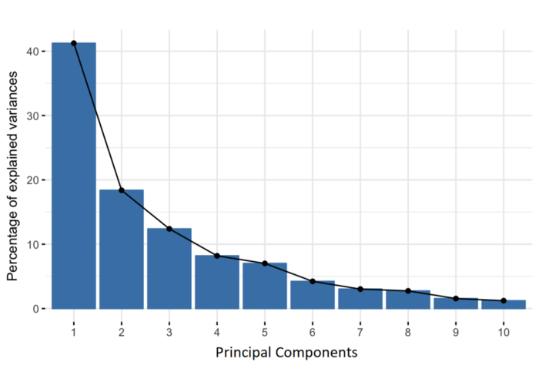
Principal component analysis
PC1 is having more information compare to other PCs

Slide 76
How Do You Do a Principal Component Analysis?:
Principal component analysis
Standardize the range of continuous initial variables
Compute the covariance matrix to identify correlations
Compute the eigenvectors and eigenvalues of the covariance matrix to identify the principal components
Create a feature vector to decide which principal components to keep
Recast the data along the principal components axes.
https://www.askpython.com/python/examples/principal-component-analysis

Slide 77
Data transformation and dimensionality reduction
Factor Analysis
Factor Analysis (FA) is an exploratory data analysis method used to search influential underlying factors or latent variables from a set of observed variables. It helps in data interpretations by reducing the number of variables. It extracts maximum common variance from all variables and puts them into a common score.
Factor analysis is a linear statistical model. It is used to explain the variance among the observed variable and condense a set of the observed variable into the unobserved variable called factors.

Slide 78
Data transformation and dimensionality reduction
Types of Factor Analysis
Exploratory Factor Analysis: It is the most popular factor analysis approach among social and management researchers. Its basic assumption is that any observed variable is directly associated with any factor.
Confirmatory Factor Analysis (CFA): Its basic assumption is that each factor is associated with a particular set of observed variables. CFA confirms what is expected on the basic.

Slide 79
Data transformation and dimensionality reduction
How does Factor Analysis Work?
The primary objective of factor analysis is to reduce the number of observed variables and find unobservable variables. These unobserved variables help the market researcher to conclude the survey. This conversion of the observed variables to unobserved variables can be achieved in two steps:
Factor Extraction
Factor Rotation

Slide 80
Data transformation and dimensionality reduction
Factor Extraction: In this step, the number of factors and approach for extraction selected using variance partitioning methods such as principal components analysis and common factor analysis.
Factor Rotation: In this step, rotation tries to convert factors into uncorrelated factors — the main goal of this step to improve the overall interpretability. There are lots of rotation methods that are available such as: Varimax rotation method, Quartimax rotation method, and Promax rotation method.

Slide 81
Data Munging
What is Data Munging?
Data munging, also known as data wrangling, is the process of converting raw data into a more usable format. Often, data munging occurs as a precursor to data analytics or data integration. High-quality data is essential for sophisticated data operations.
The munging process typically begins with a large volume of raw data. Data scientists will mung the data into shape by removing any errors or inconsistencies.

Slide 82
Data Munging
The modern data munging process now involves six main steps:
1. Discover: First, the data scientist performs a degree of data exploration. This is a first glance at the data to establish the most important patterns. It also allows the scientist to identify any major structural issues, such as invalid data formats.

Slide 83
Data Munging
2. Structure: Raw data might not have an appropriate structure for the intended usage. The data scientists will organize and normalize the data so that it’s more manageable. This also makes it easier to perform the next steps in the munging process.

Slide 84
Data Munging
3. Clean: Raw data can contain corrupt, empty, or invalid cells. There may also be values that require conversions, such as dates and currencies.. For instance, the state in a customer's address might appear as Texas, Tex, or TX. The cleaning process will standardize this value for every address.

Slide 85
Data Munging
4. Enrich: Data enrichment is the process of filling in missing details by referring to other data sources. Data enrichment lets you fill in all address fields by looking up the missing values elsewhere, such as in the CRM database or a postal records lookup.

Slide 86
Data Munging
5. Validate: Finally, it’s time to ensure that all data values are logically consistent. This means checking things like whether all phone numbers have ten digits, that there are no numbers in name fields, and that all dates are valid calendar dates. Data validation also involves some deeper checks, such as ensuring that all values are compatible with the specified data type.

Slide 87
Data Munging
6. Publish: When the data munging process is complete, the data science team will push it towards its final destination. Often this is a data repository, where it will integrate with data from other sources. This will make the munged data permanently available to all consumers.

Slide 88
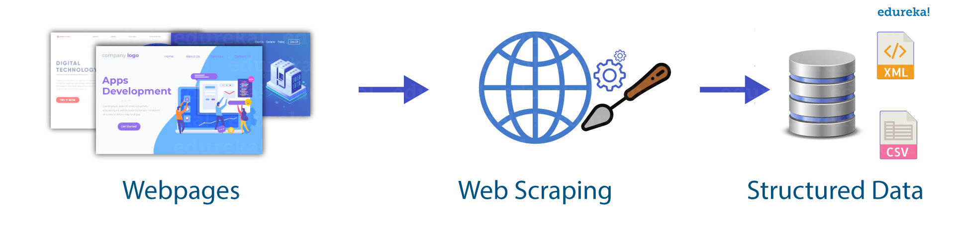
Data Munging
Web Scraping with Python Web scraping is an automated method used to extract large amounts of data from websites. The data on the websites are unstructured. Web scraping helps collect these unstructured data and store it in a structured form. There are different ways to scrape websites such as online Services, APIs or writing your own code.

Slide 89
Data Munging
To extract data using web scraping with python, you need to follow these basic steps:
Find the URL that you want to scrape
Inspecting the Page
Find the data you want to extract
Write the code
Run the code and extract the data
Store the data in the required format

Slide 90
Data Munging
Libraries used for Web Scraping
As we know, Python is has various applications and there are different libraries for different purposes. In our further demonstration, we will be using the following libraries:
Selenium: Selenium is a web testing library. It is used to automate browser activities.

Slide 91
Data Munging
Libraries used for Web Scraping
BeautifulSoup: Beautiful Soup is a Python package for parsing HTML and XML documents. It creates parse trees that is helpful to extract the data easily.
Pandas: Pandas is a library used for data manipulation and analysis. It is used to extract the data and store it in the desired format.

Slide 92
Data Munging
Web Scraping Example : Scraping Flipkart Website
Step 1: Find the URL that you want to scrape
For this example, we are going scrape Flipkart website to extract the Price, Name, and Rating of Laptops. The URL for this page is https://www.flipkart.com/laptops/~buyback-guarantee-on-laptops-/pr?sid=6bo%2Cb5g&uniqBStoreParam1=val1&wid=11.productCard.PMU_V2.

Slide 93
Data Munging
Step 2: Inspecting the Page
The data is usually nested in tags. So, we inspect the page to see, under which tag the data we want to scrape is nested. To inspect the page, just right click on the element and click on “Inspect”.

Slide 94
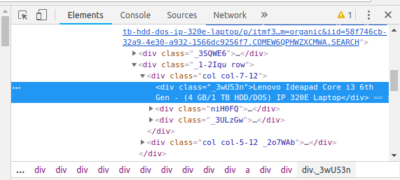
Data Munging
When you click on the “Inspect” tab, you will see a “Browser Inspector Box” open.

Slide 95
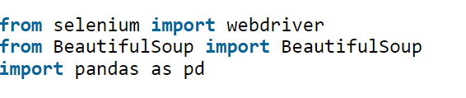
Data Munging
Step 4: Write the code
First, let’s create a Python file. To do this, open the terminal in Ubuntu and type gedit <your file name> with .py extension.
gedit web-s.py
First, let us import all the necessary libraries:

Slide 96
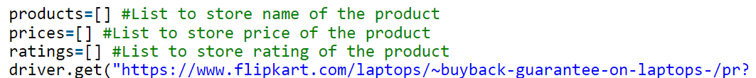
Data Munging
To configure web driver to use Chrome browser, we have to set the path to chrome driver
Refer the below code to open the URL:

Slide 97
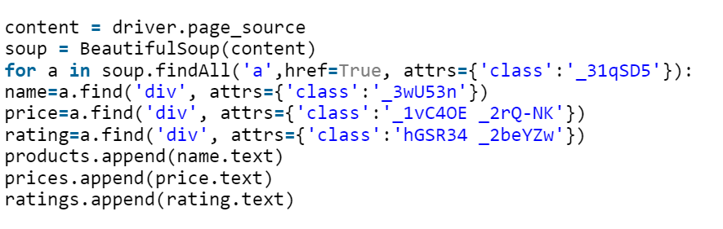
Data Munging
find the div tags with those respective class-names, extract the data and store the data in a variable

Slide 98

Data Munging
Step 5: Run the code and extract the data
To run the code, use the below command:
Step 6: Store the data in a required format
After extracting the data, you might want to store it in a format. This format varies depending on your requirement. For this example, we will store the extracted data in a CSV (Comma Separated Value) format.

Slide 99
Faculty Video Links, You tube & NPTEL Video Links and Online Courses Details
You Tube video
https://www.youtube.com/watch?v=q4pyaVZjqk0
https://www.youtube.com/watch?v=7sJaRHF03K8
https://www.youtube.com/watch?v=mKxFfjNyj3c
https://www.youtube.com/watch?v=azXCzI57Yfc
https://www.youtube.com/watch?v=83x5X66uWK0

Slide 100
Glossary Questions
Explain KDD process with Diagram.
2.Explain Data Reduction Techniques.
3.What is Data preprocessing?
4.What is Data Integration?
5.Differentiate Loose Coupling and Loose Coupling approaches of Data Integration.
6.What is Data Transformation?Why it is needed?
7.What are the benefits of Data Reduction?
8.What is Binning?
9.What is Data Aggregation?
10.Write Short notes on:
Discretization Operation
Data Cleaning
Histogram
Data Compression

Slide 101
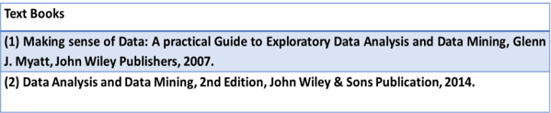
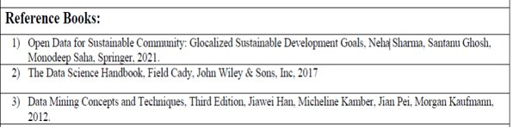
References

Slide 102
1.Explain Form of Data Pre-processing.
2.Explain Data Attribute and its types
3. Explain the techniques how to extract useful variables.
4.Explain KDD process with Diagram.
5.Explain Data Cleaning techniques.
6.Explain Missing Values and Noisy Data.
8.Explain Binning techniques .
9.What is Data Reduction?
10.Write short Notes on:
Data Cube Aggregation,
Data Compression
Numerosity Reduction.
Expected Questions for End Semester Exam

